Slide 1
Team 6 Project Inception
Rebecca Nashed, David Rademacher, and Samuel Terwilliger

Slide 2
Project Vision
Our goal is to develop an intelligent web-based chatbot capable of helping users utilize UTA's online resources to their utmost potential.

Slide 3
Customers and Users
University Systems with Online Users
Students and Faculty of University Systems
Our project will be tailored to UTA, but if we market this product, it could be generalized to other universities.

Slide 4
Features
24/7 Availability
Low User Hardware Requirements
Low Maintenance Cost
Easy Access
Intuitive Assistance

Slide 5
Top 3 Risks
Host Server Stability
Host Website Integration
Lack of Experience

Slide 6
Competitors
UTA’s Blaze Bot
UTA Help Chat
Help Desk Phone Lines

Slide 7
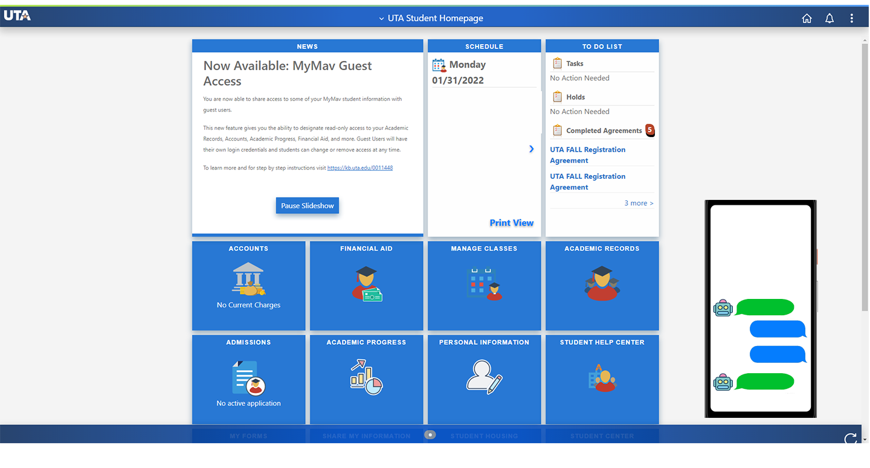
Screen Shot
* designs subject to change

Slide 8
Software Development Plan
Project Inception – 1/31
Initial presentation and plan
Iteration 1 – 2/14
Mockup/Project skeleton
Iteration 2 – 3/7
Flesh out project, add functionality, solidify path forward
Iteration 3 – 4/4
Main functionality complete, work on final touches
Final Deliverables – 4/25
Completed project and final presentation

Slide 9
Q&A

Slide 10
Resources and Citations
Repository (ver. 0.0.0)
https://github.com/banditsbeware/ooproject
Slide 7
uta.edu/mymav

